Slide 1
2.3
Market Equilibrium

Slide 2
market equilibrium: Supply and demand
How do supply and demand combined together determine the quantity and price of a good sold in the market?
Supply and demand curves intersect. At this equilibrium price quantity supplied equals quantity demanded
Equilibrium is a situation in which supply equals demand
Equilibrium price is also called as the market clearing price as quantity supplied equals quantity demanded
S NEHRA EFE UNIT II 2.3
1

Slide 3
Market Equilibrium
Balancing supply and demand
Q_{x}^{S} = Q_{x}^{d}
Steady-state
S NEHRA EFE UNIT II 2.3

Slide 4
SUPPLY AND DEMAND
What happens when market price is not equal to the equilibrium price?
Excess supply- surplus in the market
Excess demand- shortage in the market
Free markets reach equilibrium through the interaction of buyers and sellers and price is the tool through which the market is cleared.
S NEHRA EFE UNIT II 2.3
1

Slide 5
Price restrictions
Price Ceilings
The maximum legal price that can be charged
Examples:
Proposed restrictions on ATM fees
Price Floors
The minimum legal price that can be charged.
Examples:
Minimum wage
Agricultural price support
S NEHRA EFE UNIT II 2.3
1
Notes:
<number>

Slide 6
Analyzing Changes in Equilibrium: Application
Change in demand- shifts in the demand curve
Change in supply- shifts in the supply curve
Changes in both supply and demand- Change in equilibrium quantity and price
S NEHRA EFE UNIT II 2.3
1

Slide 7
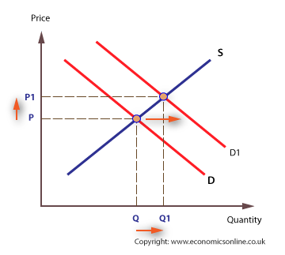
1. Demand shifts to the right
S NEHRA EFE UNIT II 2.3
1

Slide 8
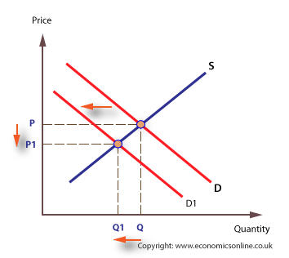
Demand shifts to the left
S NEHRA EFE UNIT II 2.3
1

Slide 9
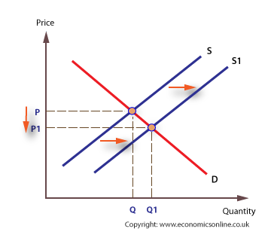
2. Supply shifts to the right
S NEHRA EFE UNIT II 2.3
1

Slide 10
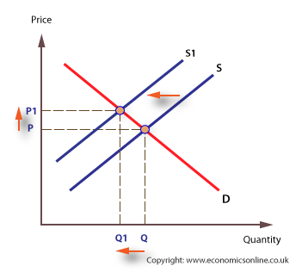
Supply shifts to the left
S NEHRA EFE UNIT II 2.3
1

Slide 11
3. Simultaneous changes in both supply and demand
S NEHRA EFE UNIT II 2.3
1

Slide 12
Applications of Demand and Supply Analysis
Event: A national newspaper reports that the prices of PC components are expected to fall by 5-8 percent over the next six months.
Scenario 1: You manage a small firm that manufactures PCs.
Scenario 2: You manage a small software company.
S NEHRA EFE UNIT II 2.3
My Answer
Sce1: Supply : Supply curve shifts
Demand :
Sce2: Supply curve shifts
1

Slide 13
both demand and supply shifts
The computer industry. Incredible improvements in technology, as well as the entry of many new firms into the industry, have increased supply.
Simultaneously, many people have become very aware of the benefits of computers, and new software has made computers more useful for a variety of projects, thereby increasing demand as well.
S NEHRA EFE UNIT II 2.3
1

Slide 14
Review question
A new movie is released after having been heavily promoted to teenagers. On the first night, the tickets sell out and there are still teenagers waiting outside theaters, desperate to see the movie and unable to get a ticket. Is this market in equilibrium?
A Japanese car manufacturer in India has produced a lot of SUVs, but now is having difficulty selling them at the price it had intended to sell them for. The cars are sitting at the warehouse unsold. Is this market in equilibrium? Explain.
S NEHRA EFE UNIT II 2.3
1
My Answer
1 No, supply less
2 No, supply more

Slide 15
Suppose the demand curve for petrol shifts to the right, as global demand from India and China increases. Suppose also that new discoveries of oil enable an increase in the supply of petrol to be sold on the market. Assuming that nothing else changes, what is the likely effect on the equilibrium price of petrol?
The equilibrium price rises.
The equilibrium price falls.
The equilibrium price remains the same.
The effect on the equilibrium price is uncertain, as it depends of the extent of the shifts in supply and demand.
S NEHRA EFE UNIT II 2.3
1
My Answer
4.

Slide 16
Which of the following would cause both the equilibrium price and equilibrium quantity of barley (assume that barley is an inferior good) to increase?
an increase in consumer income
a drought that sharply reduces barley output
a decrease in consumer income
unusually good weather that results in a bumper crop of barley
S NEHRA EFE UNIT II 2.3
1

Slide 17
Answer
a decrease in consumer income
S NEHRA EFE UNIT II 2.3
1

Slide 18
Prices of commercial airline tickets (assume that this is a normal good) have fallen in recent months. Over this same period, the price of jet fuel has risen and consumer incomes have fallen. Which of the following best explains the falling prices of airline tickets?
The supply curve for airline tickets has shifted to the left while the demand curve for airline tickets has shifted to the right.
The demand curve for airline tickets has shifted to the left more than the supply curve has shifted to the left.
The demand curve and the supply curve for airline tickets have both shifted to the right.
The supply curve for airline tickets has shifted to the left more than the demand curve has shifted to the left.
S NEHRA EFE UNIT II 2.3
1
Notes:
<number>

